Slide 1

CSCI E-25 Computer Vision
Image Stitching
Steve Elston
Copyright 2022, Stephen F Elston. All rights reserved.

Slide 2
Image Stitching
The goal of image stitching is to create a mosaic image from multiple original images
Mosaic should look like one continuous image
No seams
Consistent illumination and pixel values
Must align and blend images to create a mosaic
In this lesson we examine some of the basic CV image stitching algorithms

Slide 3
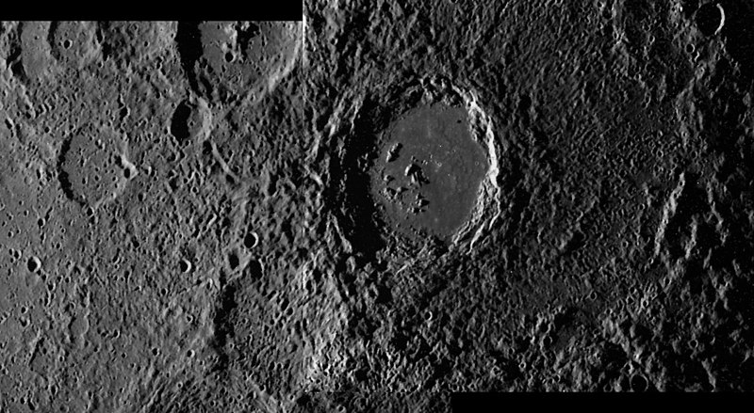
Image Stitching
Image stitching has a long history
Performed manually from 1920s into 1970s
Example, a mosaic image of the Hitomaro Mars crater – Mariner 9, 1970
Credit, Wikipedia commons

Slide 4
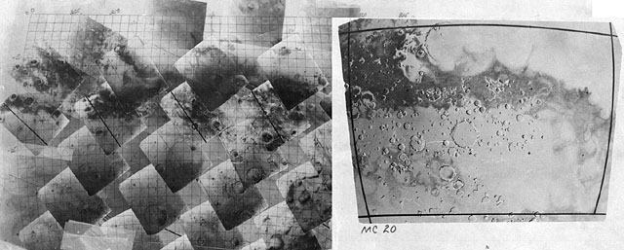
Image Stitching
Image stitching has a long history
Before CV methods photo mosaics were manually assembled for decades
Example, assembling Mariner 9 Mars images in 1970
Credit, The Planetary Society

Slide 5
Image Stitching
What are the steps for stitching images?
Take a sequence of images from the same position
E.g. rotate the camera about its optical center
Compute transformation between images
Warp one image onto the image plane of the other
Blend images together in mosaic
If more images, repeat steps 2-4

Slide 6

Image Stitching
How can we find the transform between images?
Extract interest points
Find matching descriptors
Solve equations to find holmography, $ℋ$

Slide 7
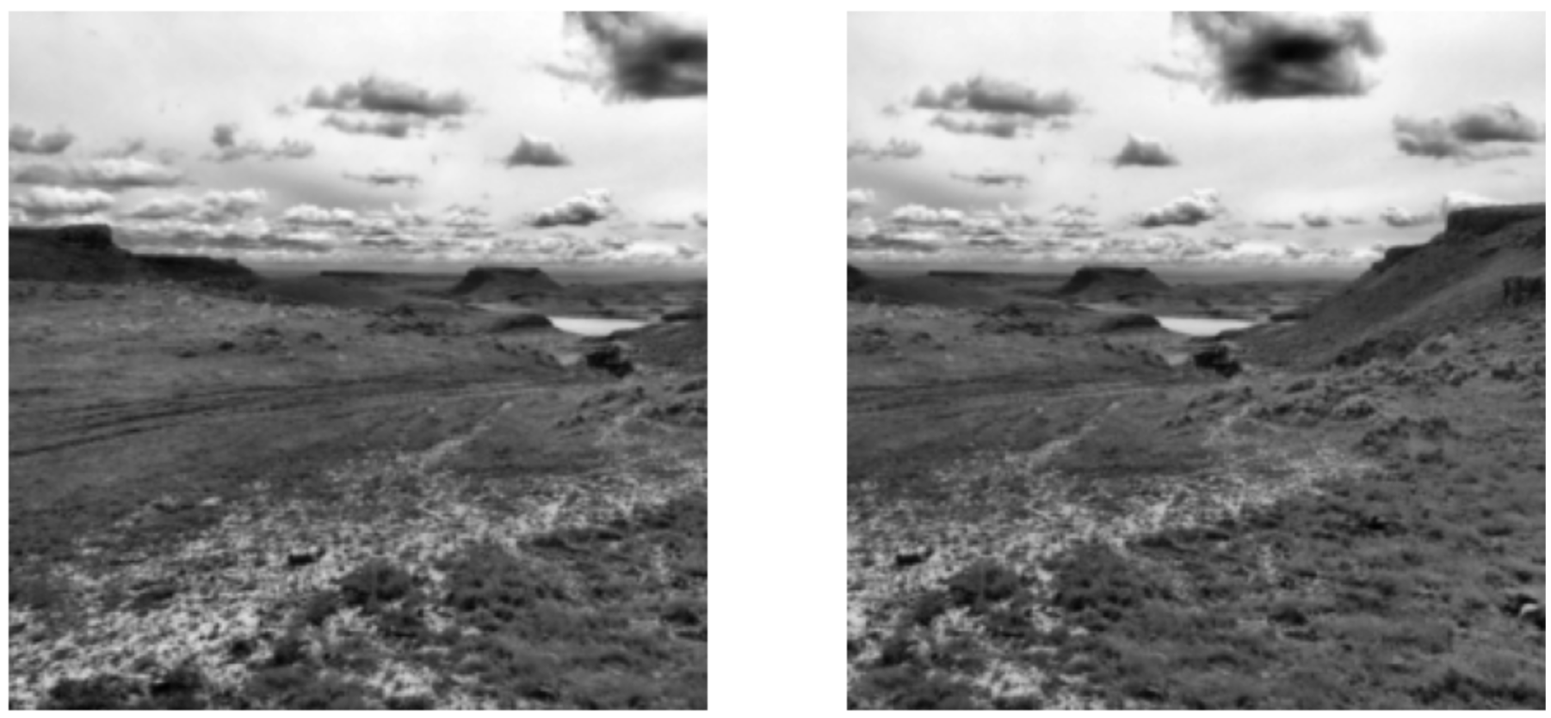
Image Stitching
Acquire multiple images by changes of camera pose

Slide 8
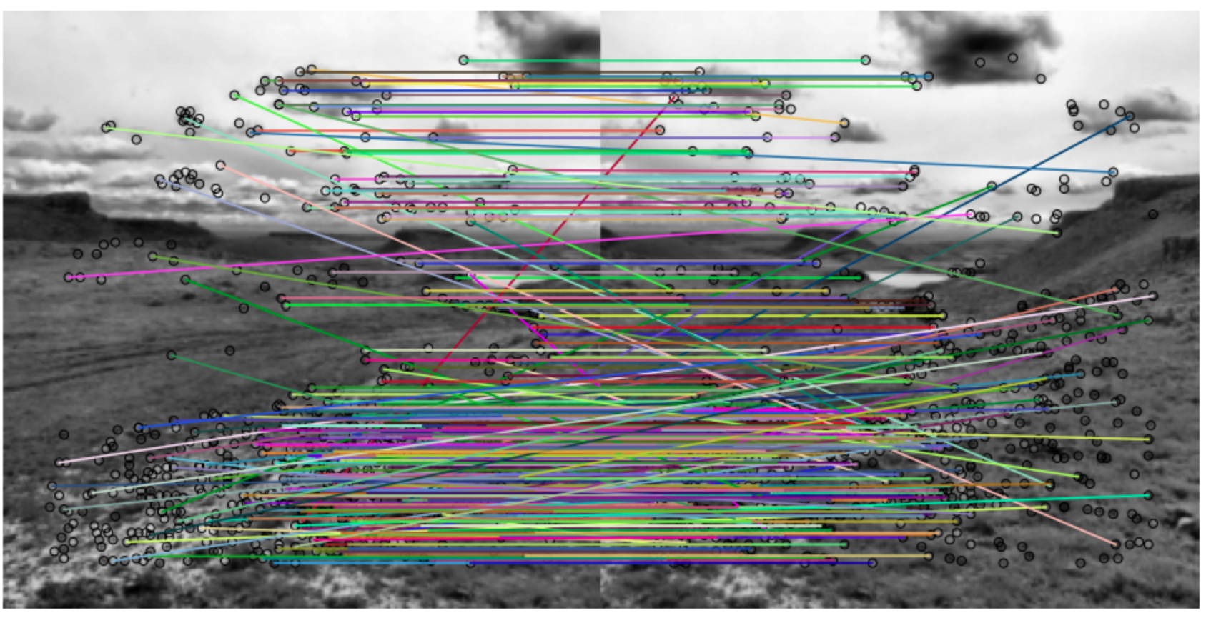
Image Stitching
Find interest points and match descriptors

Slide 9
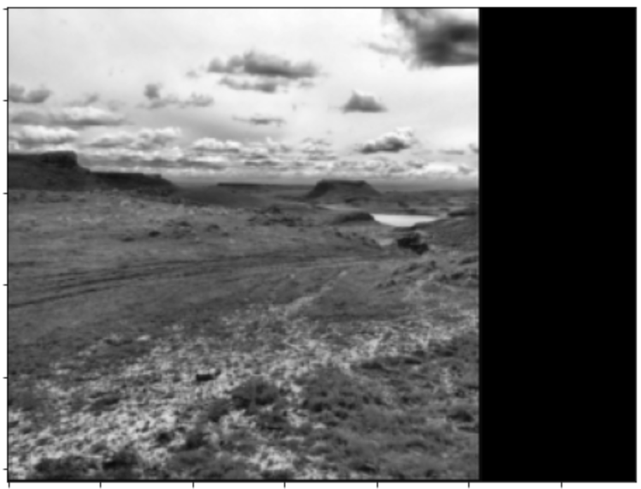
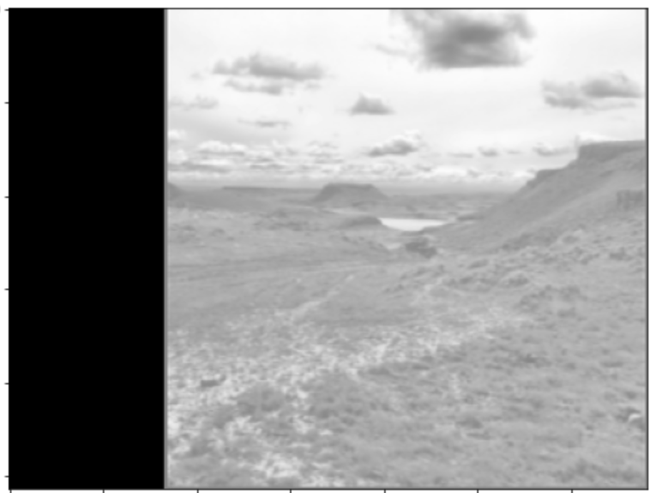
Image Stitching
Transform images to same image plane

Slide 10
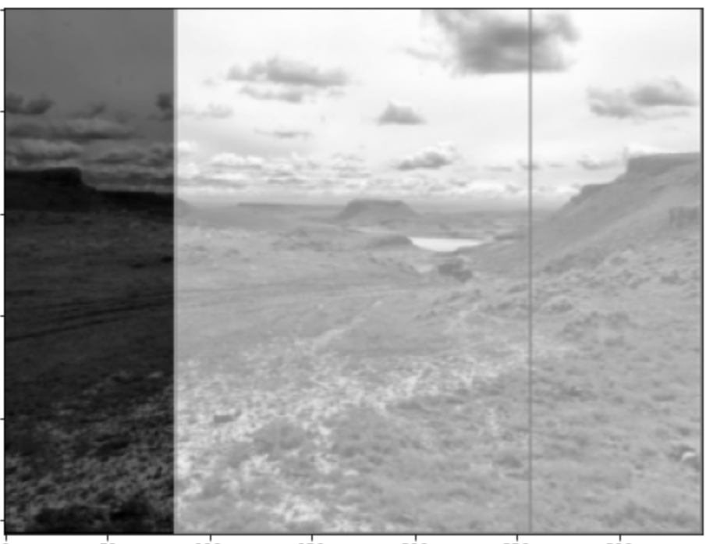
Image Stitching
Image mosaic formed
Region of overlap

Slide 11
Interest points and descriptors
Need interest points and descriptor which are scale and rotationally invariant
Interest points
Corners, edges, line intersections, etc.
High gradients
Ideally scale and rotationally invariant
Descriptors
Uniquely identify interest points
Use image characteristics within patch around interest point

Slide 12
Interest points and descriptors
Review of interest points and descriptors
Rotationally invariant interest point detectors
Harris
etc.
Descriptors
SHIFT
FAST
BRIEF
etc

Slide 13
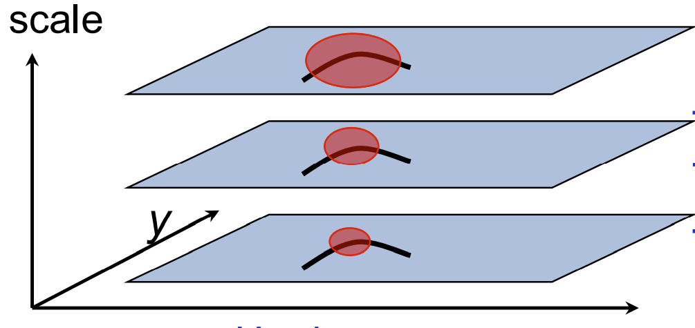
Multi-scale interest point detection
Pyramid structure enables extraction of interest points at several scales
Pyramid scales from fine to coarse in octaves
Features at each scale extracted
Can use a variety of interest point descriptor algorithms
SIFT
Harris – Laplacian

Slide 14
Planar transformations
Can use different approximations for image stitching
Cylindrical coordinates
Assume camera rotates about an axis
Spherical coordinates
Allows camera to rotate unrestricted
Planar
Good approximation if objects far from camera
Good approximation for small changes in camera pose
Our focus here for simplicity

Slide 15
Planar transformations
Planar transformation maps one image plan to another
Two images planes from a camera centre
Project one image plane onto the other
Camera Center

Slide 16
Planar transformations
Can use different approximations for image stitching
Can use different transformation depending on changes in camera pose
2-D Euclidean – Rotation about optic axis and translation
3 DoF
2-D Similarity – Rotation, translation, and scaling
4 DoF
Affine - Rotation, translation, scaling, shearing
6 DoF
Projective – General transformation
8 DoF

Slide 17
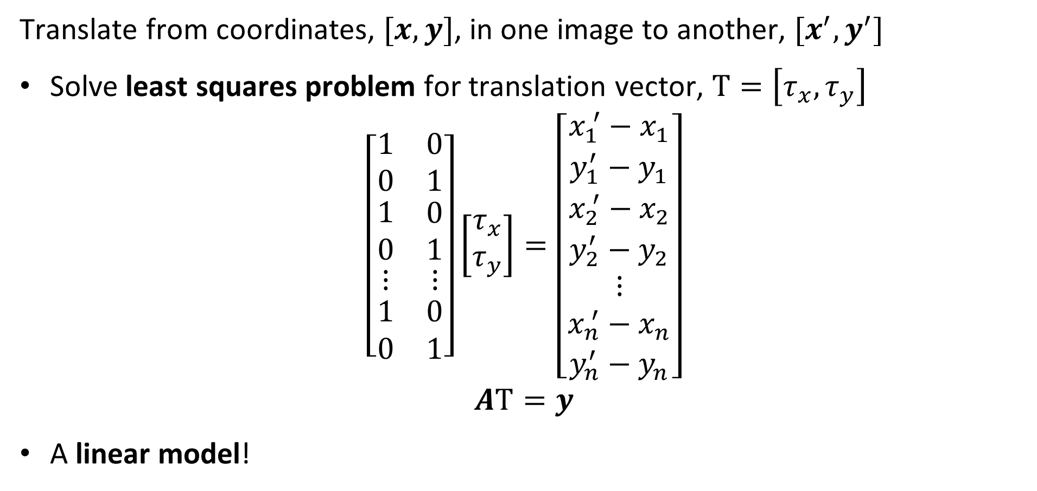
Pure translation
Translate from coordinates, $[x,y]$, in one image to another, $[x^{′},y^{′}]$
Solve least squares problem for translation vector, $Τ=\left[τ_{x},τ_{y}\right]$
$$\left[\begin{matrix}1 & 0 \\ 0 & 1 \\ \begin{matrix}1 \\ 0 \\ \begin{matrix}⋮ \\ \begin{matrix}1 \\ 0\end{matrix}\end{matrix}\end{matrix} & \begin{matrix}0 \\ 1 \\ \begin{matrix}⋮ \\ \begin{matrix}0 \\ 1\end{matrix}\end{matrix}\end{matrix}\end{matrix}\right]\left[\begin{matrix}τ_{x} \\ τ_{y}\end{matrix}\right]=\left[\begin{matrix}x_{1}^{ ′}−x_{1} \\ y_{1}^{′}−y_{1} \\ \begin{matrix}x_{2}^{ ′}−x_{2} \\ y_{2}^{′}−y_{2} \\ \begin{matrix}⋮ \\ x_{n}^{ ′}−x_{n} \\ y_{n}^{′}−y_{n}\end{matrix}\end{matrix}\end{matrix}\right]$$
$$AΤ=y$$
A linear model!

Slide 18
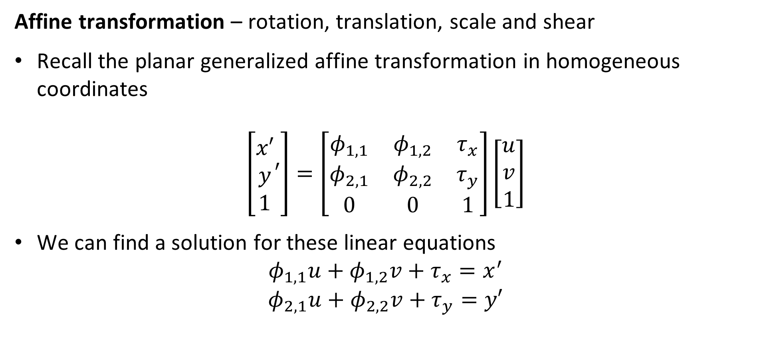
Affine transformation
Affine transformation – rotation, translation, scale and shear
Recall the planar generalized affine transformation in homogeneous coordinates
$$\left[\begin{matrix}x′ \\ y \\ 1\end{matrix}′\right]=\left[\begin{matrix}φ_{1,1} & φ_{1,2} & τ_{x} \\ φ_{2,1} & φ_{2,2} & τ_{y} \\ 0 & 0 & 1\end{matrix}\right]\left[\begin{matrix}u \\ v \\ 1\end{matrix}\right]$$
We can find a solution for these linear equations
$$φ_{1,1}u+φ_{1,2}v+τ_{x}=x^{′}$$
$$φ_{2,1}u+φ_{2,2}v+τ_{y}=y′$$

Slide 19
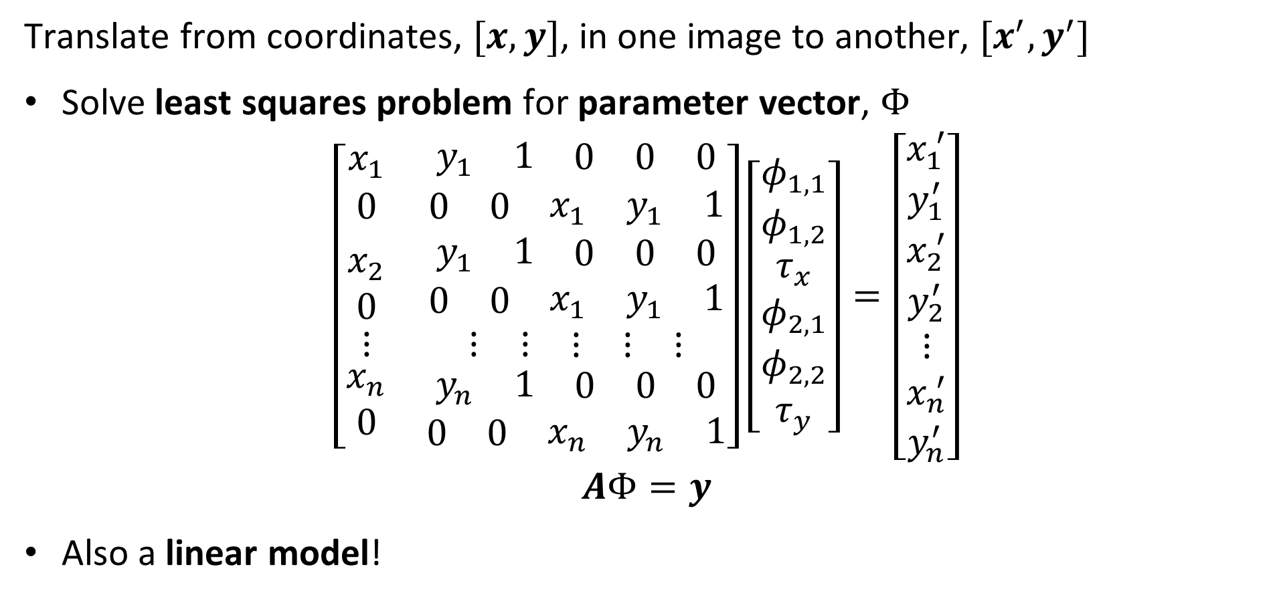
Affine transformation
Translate from coordinates, $[x,y]$, in one image to another, $[x^{′},y^{′}]$
Solve least squares problem for parameter vector, $Φ$
$$\left[\begin{matrix}x_{1} & \begin{matrix}y_{1} & 1 & \begin{matrix}0 & 0 & 0\end{matrix}\end{matrix} \\ 0 & \begin{matrix}0 & 0 & \begin{matrix}x_{1} & y_{1} & 1\end{matrix}\end{matrix} \\ \begin{matrix}x_{2} \\ 0 \\ \begin{matrix}⋮ \\ \begin{matrix}x_{n} \\ 0\end{matrix}\end{matrix}\end{matrix} & \begin{matrix}\begin{matrix}y_{1} & 1 & \begin{matrix}0 & 0 & 0\end{matrix}\end{matrix} \\ \begin{matrix}0 & 0 & \begin{matrix}x_{1} & y_{1} & 1\end{matrix}\end{matrix} \\ \begin{matrix}\begin{matrix}⋮ & ⋮ & \begin{matrix}⋮ & ⋮ & ⋮\end{matrix}\end{matrix} \\ \begin{matrix}\begin{matrix}y_{n} & 1 & \begin{matrix}0 & 0 & 0\end{matrix}\end{matrix} \\ \begin{matrix}0 & 0 & \begin{matrix}x_{n} & y_{n} & 1\end{matrix}\end{matrix}\end{matrix}\end{matrix}\end{matrix}\end{matrix}\right]\left[\begin{matrix}φ_{1,1} \\ φ_{1,2} \\ \begin{matrix}τ_{x} \\ φ_{2,1} \\ \begin{matrix}φ_{2,2} \\ τ_{y}\end{matrix}\end{matrix}\end{matrix}\right]=\left[\begin{matrix}x_{1}^{ ′} \\ y_{1}^{′} \\ \begin{matrix}x_{2}^{ ′} \\ y_{2}^{′} \\ \begin{matrix}⋮ \\ x_{n}^{ ′} \\ y_{n}^{′}\end{matrix}\end{matrix}\end{matrix}\right]$$
$$AΦ=y$$
Also a linear model!

Slide 20
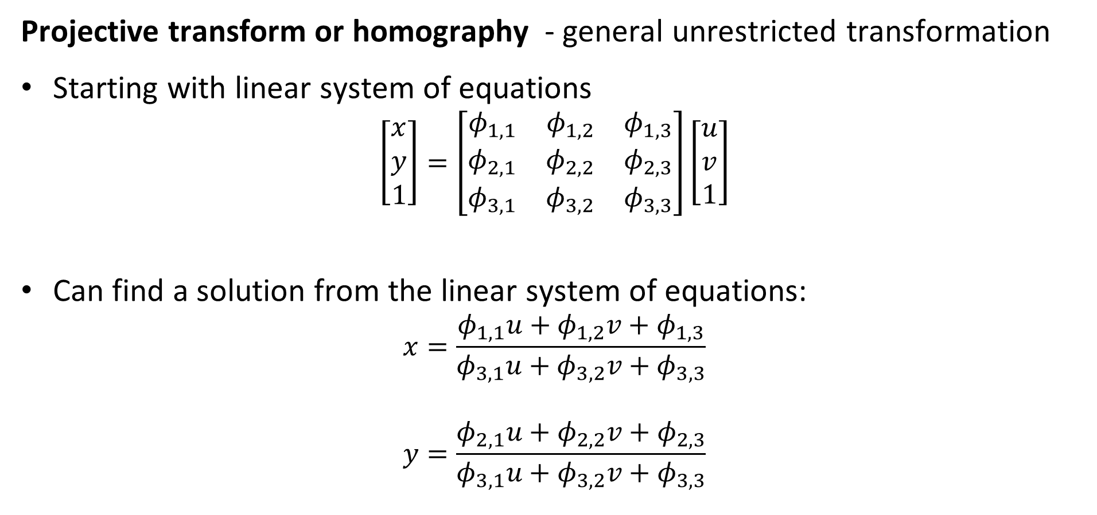
Projective transformation
Projective transform or homography - general unrestricted transformation
Starting with linear system of equations
$$\left[\begin{matrix}x \\ y \\ 1\end{matrix}\right]=\left[\begin{matrix}φ_{1,1} & φ_{1,2} & φ_{1,3} \\ φ_{2,1} & φ_{2,2} & φ_{2,3} \\ φ_{3,1} & φ_{3,2} & φ_{3,3}\end{matrix}\right]\left[\begin{matrix}u \\ v \\ 1\end{matrix}\right]$$
Can find a solution from the linear system of equations:
$$x=\frac{φ_{1,1}u+φ_{1,2}v+φ_{1,3}}{φ_{3,1}u+φ_{3,2}v+φ_{3,3}}$$
$$y=\frac{φ_{2,1}u+φ_{2,2}v+φ_{2,3}}{φ_{3,1}u+φ_{3,2}v+φ_{3,3}}$$

Slide 21
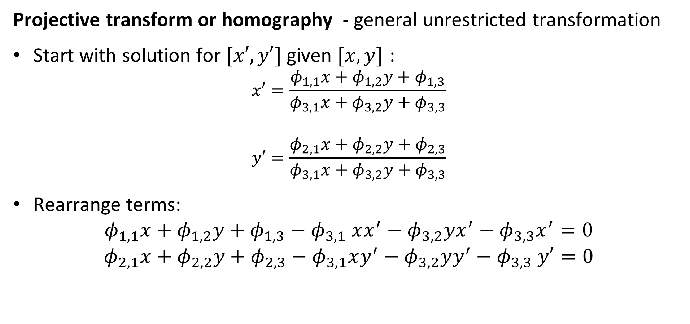
Projective transformation
Projective transform or homography - general unrestricted transformation
Start with solution for $[x′,y′]$ given $[x,y]$ :
$$x′=\frac{φ_{1,1}x+φ_{1,2}y+φ_{1,3}}{φ_{3,1}x+φ_{3,2}y+φ_{3,3}}$$
$$y′=\frac{φ_{2,1}x+φ_{2,2}y+φ_{2,3}}{φ_{3,1}x+φ_{3,2}y+φ_{3,3}}$$
Rearrange terms:
$$φ_{1,1}x+φ_{1,2}y+φ_{1,3}{− φ}_{3,1}xx^{′}−φ_{3,2}yx^{′}−φ_{3,3}x^{′}=0$$
$$φ_{2,1}x+φ_{2,2}y+φ_{2,3}−φ_{3,1}xy^{′}−φ_{3,2}yy^{′}−φ_{3,3} y′=0$$

Slide 22
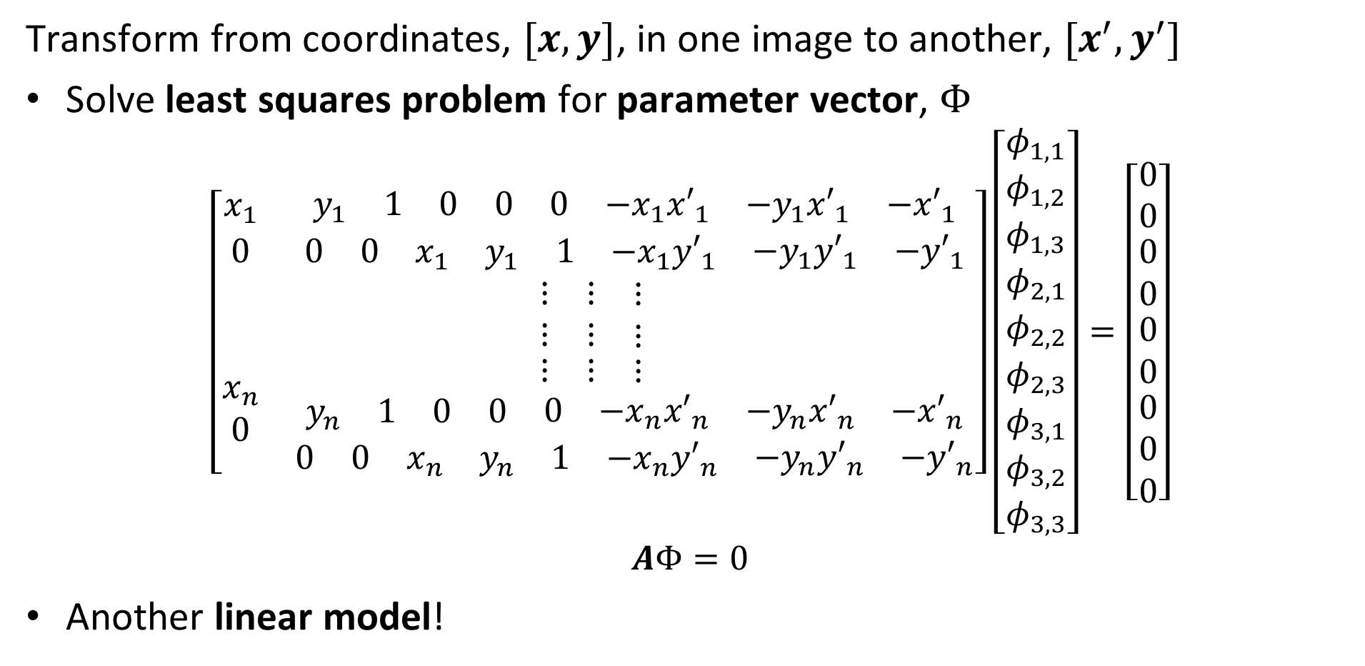
Projective transformation
Transform from coordinates, $[x,y]$, in one image to another, $[x^{′},y^{′}]$
Solve least squares problem for parameter vector, $Φ$
$$\left[\begin{matrix}x_{1} & \begin{matrix}y_{1} & 1 & \begin{matrix}0 & 0 & \begin{matrix}0 & −x_{1}{x′}_{1} & \begin{matrix}{−y}_{1}{x′}_{1} & {−x′}_{1}\end{matrix}\end{matrix}\end{matrix}\end{matrix} \\ 0 & \begin{matrix}0 & 0 & \begin{matrix}x_{1} & y_{1} & \begin{matrix}1 & {−x}_{1}{y′}_{1} & \begin{matrix}{−y}_{1}{y′}_{1} & {−y′}_{1}\end{matrix}\end{matrix}\end{matrix}\end{matrix} \\ \begin{matrix} \\ \\ \begin{matrix} \\ \begin{matrix}x_{n} \\ 0\end{matrix}\end{matrix}\end{matrix} & \begin{matrix}\begin{matrix}⋮ & ⋮ & \begin{matrix}⋮ & & \end{matrix}\end{matrix} \\ \begin{matrix}⋮ & ⋮ & \begin{matrix}⋮ & & \end{matrix}\end{matrix} \\ \begin{matrix}\begin{matrix}⋮ & ⋮ & \begin{matrix}⋮ & & \end{matrix}\end{matrix} \\ \begin{matrix}\begin{matrix}y_{n} & 1 & \begin{matrix}0 & 0 & \begin{matrix}0 & {−x}_{n}{x′}_{n} & \begin{matrix}{−y}_{n}{x′}_{n} & {−x′}_{n}\end{matrix}\end{matrix}\end{matrix}\end{matrix} \\ \begin{matrix}0 & 0 & \begin{matrix}x_{n} & y_{n} & \begin{matrix}1 & {−x}_{n}{y′}_{n} & \begin{matrix}{−y}_{n}{y′}_{n} & {−y′}_{n}\end{matrix}\end{matrix}\end{matrix}\end{matrix}\end{matrix}\end{matrix}\end{matrix}\end{matrix}\right]\left[\begin{matrix}φ_{1,1} \\ φ_{1,2} \\ \begin{matrix}φ_{1,3} \\ φ_{2,1} \\ \begin{matrix}φ_{2,2} \\ \begin{matrix}φ_{2,3} \\ φ_{3,1} \\ \begin{matrix}φ_{3,2} \\ φ_{3,3}\end{matrix}\end{matrix}\end{matrix}\end{matrix}\end{matrix}\right]=\left[\begin{matrix}0 \\ 0 \\ \begin{matrix}0 \\ 0 \\ \begin{matrix}0 \\ 0 \\ \begin{matrix}0 \\ 0 \\ 0\end{matrix}\end{matrix}\end{matrix}\end{matrix}\right]$$
$$AΦ=0$$
Another linear model!

Slide 23

Solving for the transformation parameters
$[x,y]$, $[x^{′},y^{′}]$, pairs found by using matched descriptors
Notice the obvious matching errors – These are outliers!

Slide 24
Solving for the transformation parameters
Use matching descriptors to find points fit transform parameters
Cannot use ordinary least squares because of outliners
Outliers exhibit undue influence on the solution
Need way to control influence of outliers
M-estimators, limit influence of outliers – e.g. Huber estimator
Resampling method to find only inliers for solution

Slide 25
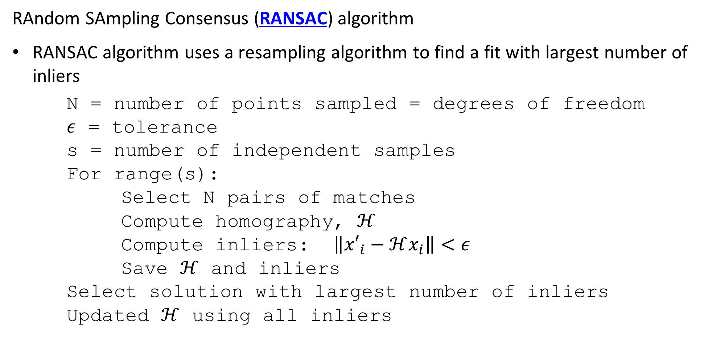
Solving for the transformation parameters
RAndom SAmpling Consensus (RANSAC) algorithm
RANSAC algorithm uses a resampling algorithm to find a fit with largest number of inliers
N = number of points sampled = degrees of freedom
$ε$ = tolerance
s = number of independent samples
For range(s):
Select N pairs of matches
Compute homography, $ℋ$
Compute inliers: $\left\|{x′}_{i}−ℋx_{i}\right\|<ε$
Save $ℋ$ and inliers
Select solution with largest number of inliers
Updated $ℋ$ using all inliers
Notes:
N

Slide 26
Solving for the transformation parameters
RAndom SAmpling Concensus (RANSAC) algorithm example
s = 3
Let DoF = 2
Notes:
n

Slide 27
Solving for the transformation parameters
RAndom SAmpling Concensus (RANSAC) algorithm example
s = 3
Let DoF = 2
Select 2 points at random
Notes:
n

Slide 28
Solving for the transformation parameters
RAndom SAmpling Concensus (RANSAC) algorithm example
s = 3
Let DoF = 2
Select 2 points at random
Fit line
Notes:
n

Slide 29
Solving for the transformation parameters
RAndom SAmpling Concensus (RANSAC) algorithm example
s = 3
Let DoF = 2
Select 2 points at random
Fit line
Identify inliers = 7
Notes:
n

Slide 30
Solving for the transformation parameters
RAndom SAmpling Concensus (RANSAC) algorithm example
s = 3
Let DoF = 2
Select 2 points at random
Notes:
n

Slide 31
Solving for the transformation parameters
RAndom SAmpling Concensus (RANSAC) algorithm example
s = 3
Let DoF = 2
Select 2 points at random
Notes:
n

Slide 32
Solving for the transformation parameters
RAndom SAmpling Concensus (RANSAC) algorithm example
s = 3
Let DoF = 2
Select 2 points at random
Fit line
Notes:
n

Slide 33
Solving for the transformation parameters
RAndom SAmpling Concensus (RANSAC) algorithm example
s = 3
Let DoF = 2
Select 2 points at random
Fit line
Identify inliers = 5
Notes:
n

Slide 34
Solving for the transformation parameters
RAndom SAmpling Concensus (RANSAC) algorithm example
s = 3
Let DoF = 2
Select 2 points at random
Notes:
n

Slide 35
Solving for the transformation parameters
RAndom SAmpling Concensus (RANSAC) algorithm example
s = 3
Let DoF = 2
Select 2 points at random
Fit line
Notes:
n

Slide 36
Solving for the transformation parameters
RAndom SAmpling Concensus (RANSAC) algorithm example
S = 3
Let DoF = 2
Select 2 points at random
Fit line
Identify inliers = 11
Notes:
n

Slide 37
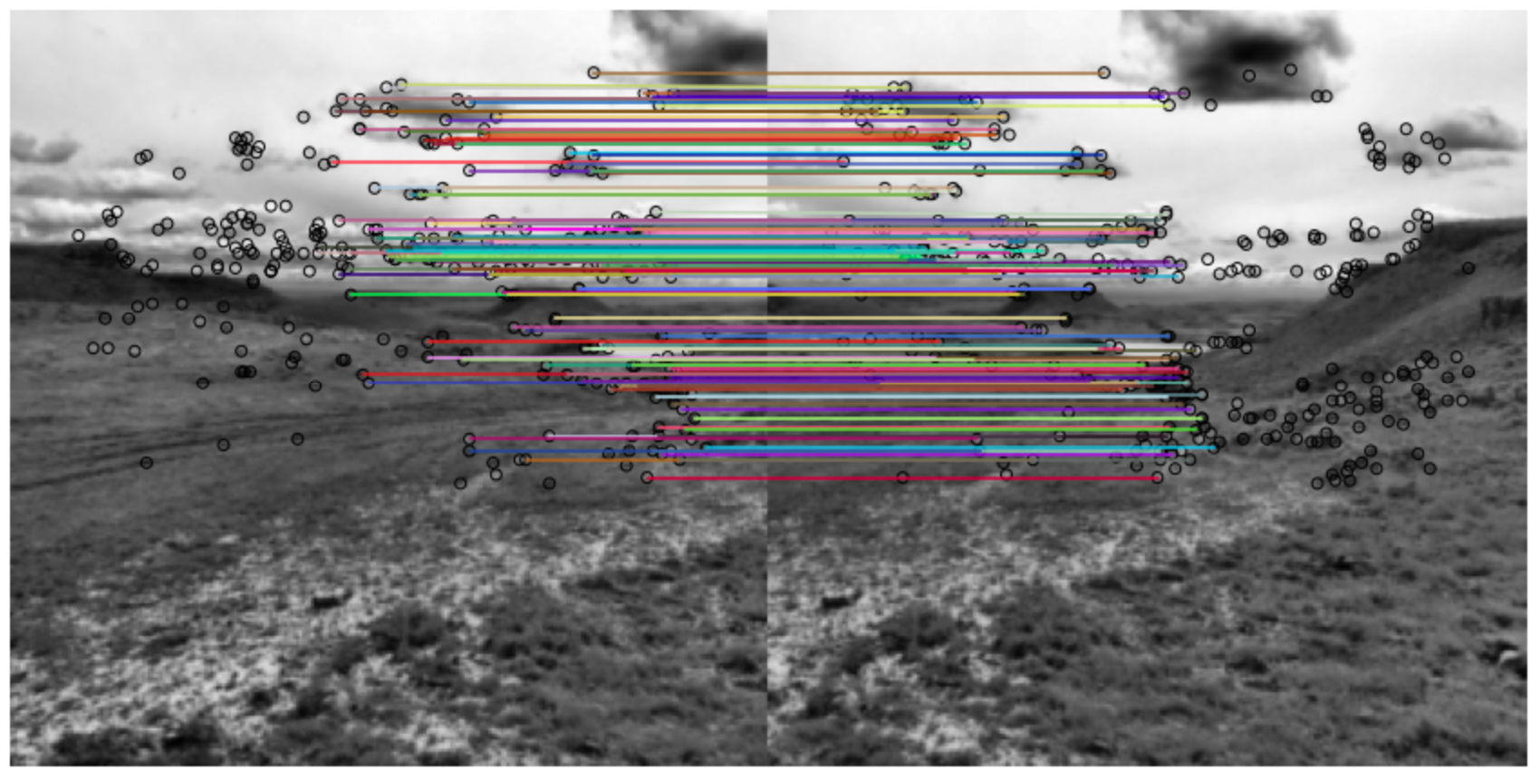
Solving for the transformation parameters
RAndom SAmpling Concensus (RANSAC) algorithm example
Least squares fit based only on inliers

Slide 38
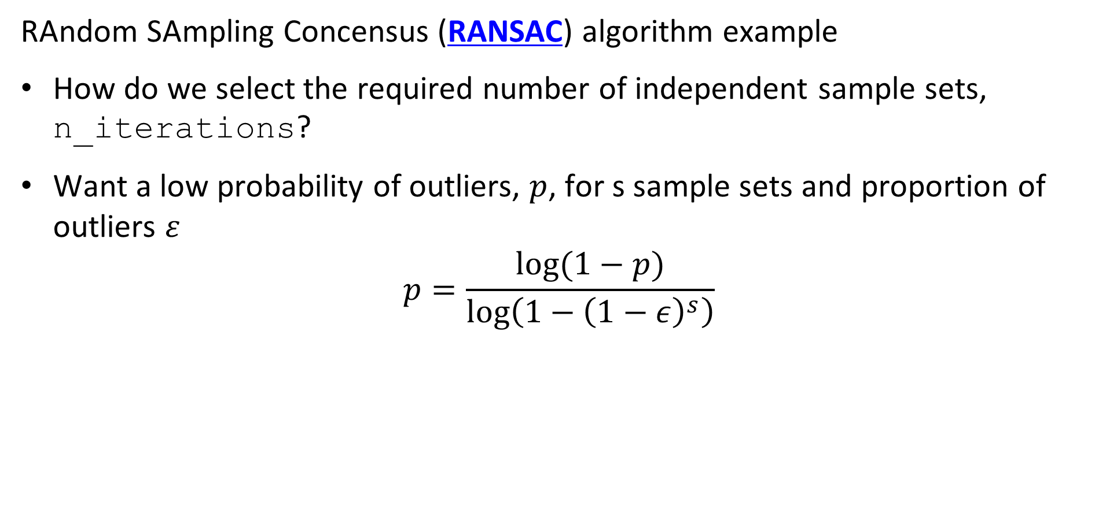
Solving for the transformation parameters
RAndom SAmpling Concensus (RANSAC) algorithm example
How do we select the required number of independent sample sets, n_iterations?
Want a low probability of outliers, $p$, for s sample sets and proportion of outliers $ε$
$$p=\frac{log⁡(1−p)}{log\left(1−{\left(1−ε\right)}^{s}\right)⁡}$$
Notes:
n

Slide 39
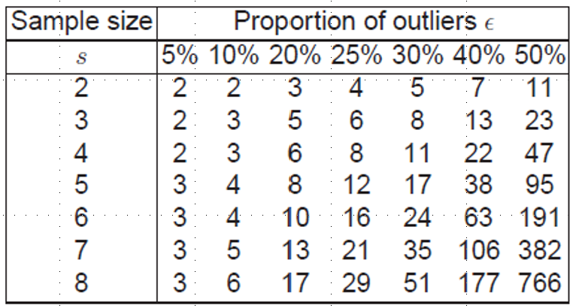
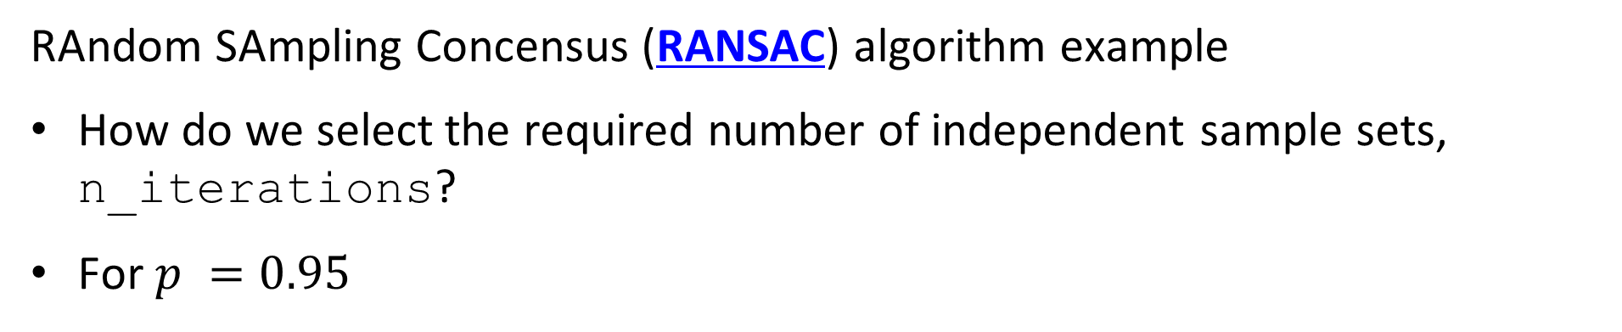
Solving for the transformation parameters
RAndom SAmpling Concensus (RANSAC) algorithm example
How do we select the required number of independent sample sets, n_iterations?
For $p =0.95$
Notes:
n

Slide 40
Solving for the transformation parameters
Improving the least squares fit.
The RANSAC algorithm uses only a limited number of inliers to fit a transform model
Limited number of observations increases variance of the estimated parameters
How can we improve this result?
Use the current set of inliers as exemplars to find other matches with similar slope
Compute least squares fit with larger number of observations
See Szelisski Section 8.1.3
Notes:
n

Slide 41
Solving for the transformation parameters
Improving the least squares fit.
Planar projections introduce distortion in object locations near camera center
Least squares fit for planar projects is not guaranteed to be globally optimal
Use cylindrical coordinates
Less distortion is camera centers collocated
More likely to find globally optimal solution
See Szelisski Section 8.2.3
Notes:
n

Slide 42
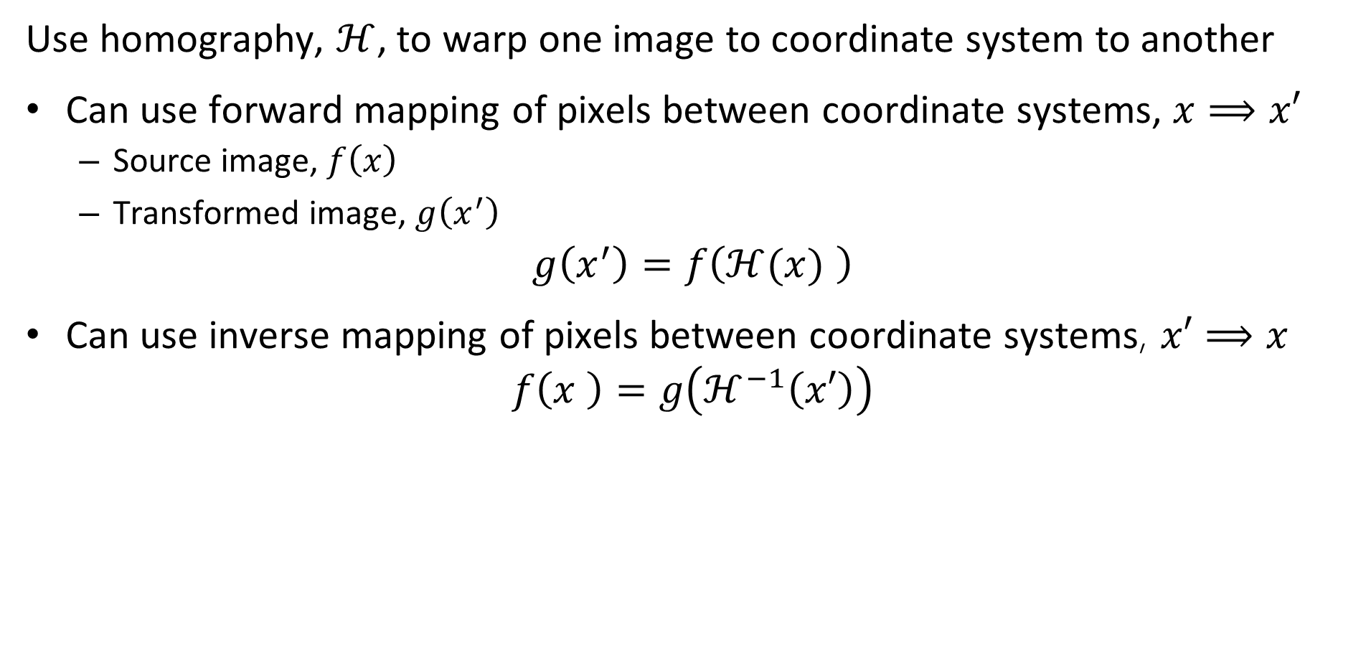
Image Warping
Use homography, $ℋ$, to warp one image to coordinate system to another
Can use forward mapping of pixels between coordinate systems, $x⟹x′$
Source image, $f\left(x\right)$
Transformed image, $g\left(x^{′}\right)$
$$g\left(x^{′}\right)=f\left(ℋ(x) \right)$$
Can use inverse mapping of pixels between coordinate systems, $x′⟹x$
$$f\left(x \right)=g\left(ℋ^{−1}\left(x′\right)\right)$$
Notes:
n

Slide 43
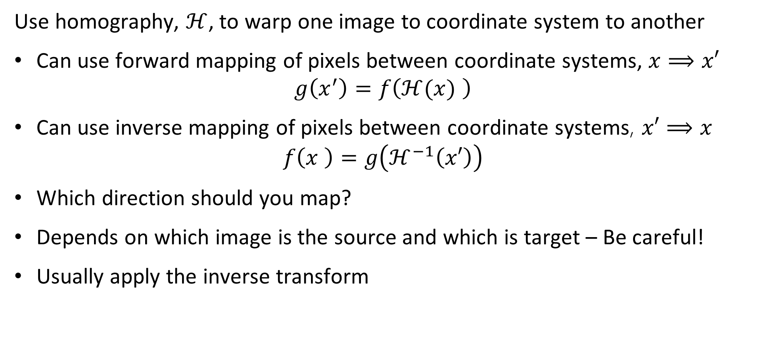
Image Warping
Use homography, $ℋ$, to warp one image to coordinate system to another
Can use forward mapping of pixels between coordinate systems, $x⟹x′$
$$g\left(x^{′}\right)=f\left(ℋ(x) \right)$$
Can use inverse mapping of pixels between coordinate systems, $x′⟹x$
$$f\left(x \right)=g\left(ℋ^{−1}\left(x′\right)\right)$$
Which direction should you map?
Depends on which image is the source and which is target – Be careful!
Usually apply the inverse transform
Notes:
n

Slide 44
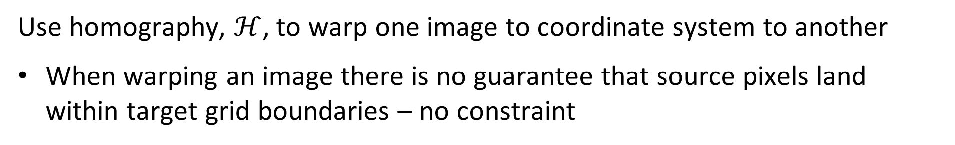

Image Warping
Use homography, $ℋ$, to warp one image to coordinate system to another
When warping an image there is no guarantee that source pixels land within target grid boundaries – no constraint
Homography, $ℋ$
Target Image
Pixel Grid
Source Image Pixel Grid
Warped Image Pixel Grid
Notes:
n

Slide 45
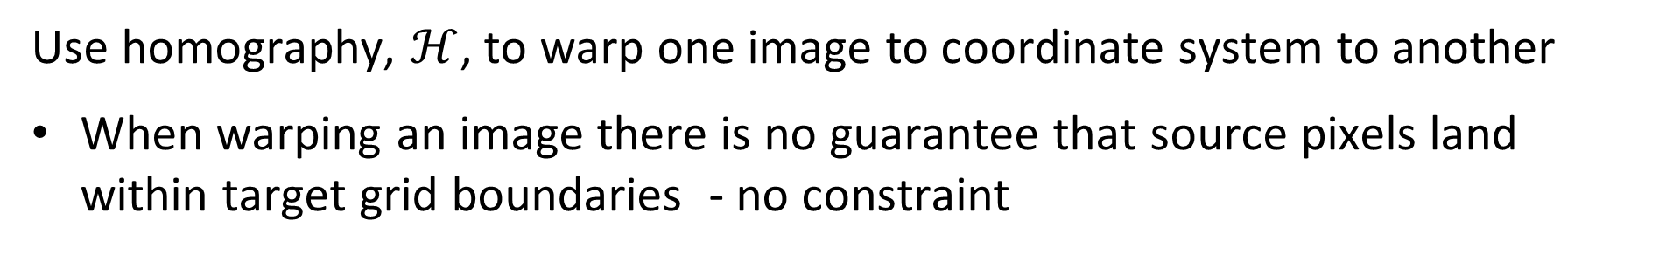
Image Warping
Use homography, $ℋ$, to warp one image to coordinate system to another
When warping an image there is no guarantee that source pixels land within target grid boundaries - no constraint
Values of warped pixel fall into several target pixels
Warped pixel values influence several
Need to interpolate!
Target Image
Pixel Grid
Warped Image Pixel Grid
Notes:
n

Slide 46
Image Warping
When warping an image there is no guarantee that source pixels land within target grid boundaries - no constraint
Interpolate fill pixel values
Scikit Image supports several of possible methods
0: Nearest-neighbor
1: Bi-linear (default)
2: Bi-quadratic
3: Bi-cubic
4: Bi-quartic
5: Bi-quintic
Target Image
Pixel Grid
Warped Image Pixel Grid
Notes:
n

Slide 47
Image Blending
How can we make the transitions in the mosaic less noticeable?
Region of overlap

Slide 48
Image Blending
How can we make the transitions in the mosaic less noticeable?
Blend one image into another over the region of overlap
Resulting pixel values are weighted sum of overlapping image pixel values
Blend different scales with pyramid
Blend R,G,B channels
Different blending function, linear, Gaussian, etc.
Adjust illumination
Equalize illumination between images in mosaic
Can still be problems, e.g. shadows
Notes:
n

Slide 49
Image Blending
Use interpolation to find weights
Sum of interpolation weights must add to 1.0
Linearly weight pixel values over range of overlap
Sum weighted pixel values to form blended
Region of overlap

Slide 50
Image Blending
How can we make the transitions in the mosaic less noticeable?
Compute Gaussian Laplacian pyramids of images
Pyramid for each color channel
Compute blending weights for each scale
Blend Laplacians using weights
Construct mosaic using weighted scales from pyramids
Notes:
n

Slide 51
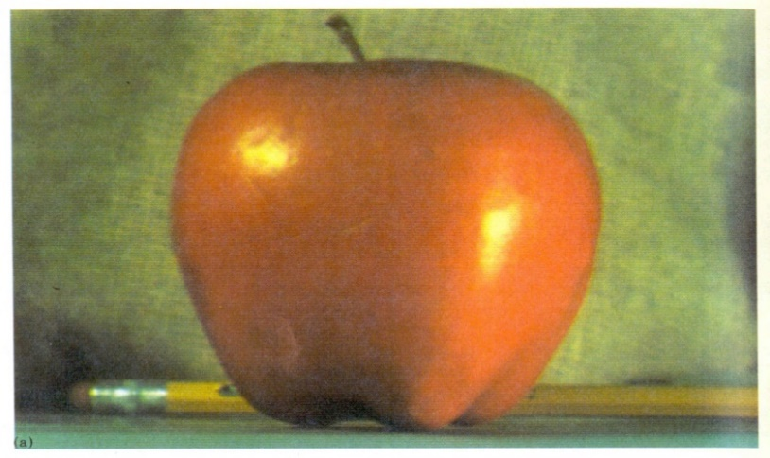
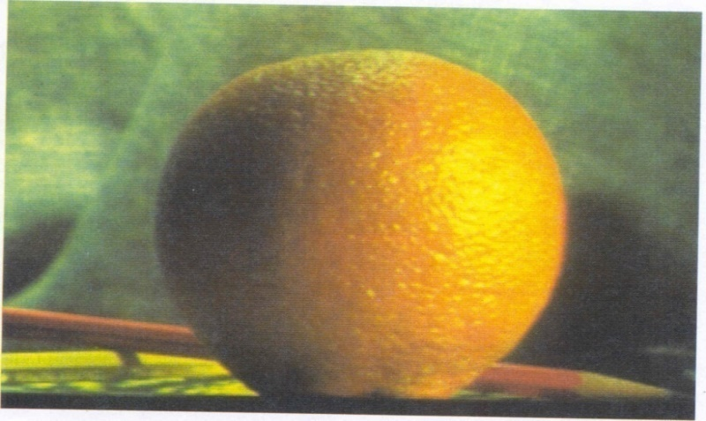
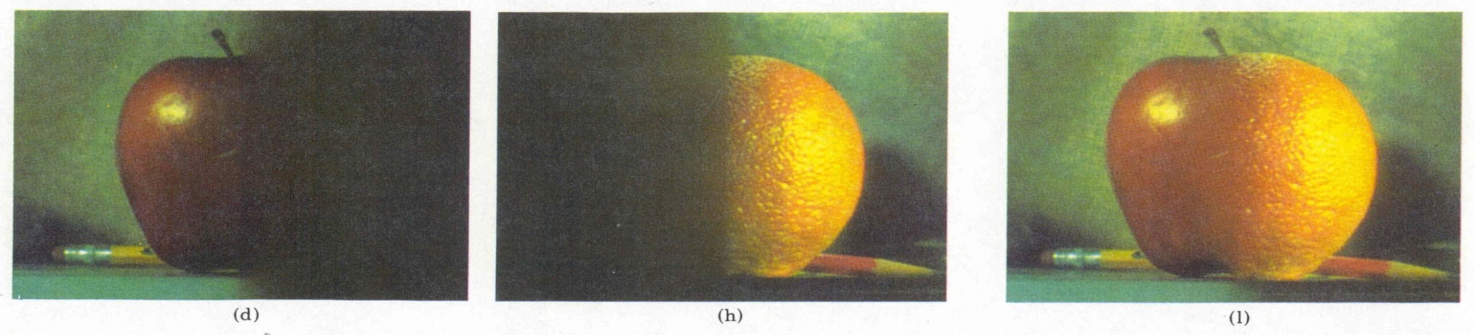
Image Blending
Image blending with scale pyramid is used in computer graphics
Burt, P. J. and Adelson, E. H., A multiresolution spline with applications to image mosaics, ACM Transactions on Graphics, 42(4), October 1983, 217-236.
Notes:
n

Slide 52
Image Blending
How can we make the transitions in the mosaic less noticeable?
There are several alternatives to weight blending
E.G., use image seam carving to minimize discontinuity
‘Low energy’ seam is less noticeable
Join images along low energy seam Bs
Compute image energy
Find minimum energy path – classic graph theory problem – heuristic solution with dynamic programming
Example for image blending with Scikit Image in GitHub
Algorithm widely used for image resizing
Notes:
n

